Slide 1
Creating a 30-Day
Promotion Calendar
Without Burnout
LaShaunda Hoffman • Reader Relationship Strategist

Slide 2
Today’s Goal
Build a promotion plan that supports your writing—not competes with it.
Leave with a repeatable 30-day calendar you can use every month.
Focus on three jobs:
•Visibility
• Connection
• Conversion
Creating a 30-Day Promotion Calendar Without Burnout • 2

Slide 3

Who Is LaShaunda C. Hoffman
Reader Relationship Strategist
Author
Podcaster
Blogger
Speaker
Grief Advocate
Veteran
Wife
Mother
Sister
Friend
Grandmother
Creating a 30-Day Promotion Calendar Without Burnout • 3

Slide 4
Why Promotion Feels Exhausting
Trying to post every day
Starting from a blank screen
Creating every piece of content from scratch
Switching between writing and marketing all day
Mistaking “more content” for “better promotion”
Trying to be everywhere
Winging it and not having a plan
What is your biggest drain?
Creating a 30-Day Promotion Calendar Without Burnout • 4

Slide 5
What’s In Your Content Bucket?
Bucket Content Idea Format
(Post/Video/Story/Email)
Behind the Scenes My morning writing routine Instagram post + story
Book Highlight 1-minute excerpt reading. Reel/Audio
Reader Engagement Ask: “How do you choose your next book? Facebook post
Personal Connection What was the last Kdrama you watched? Threads Post
Expertise 3 Ways I stay motivated to write. LinkedIn article
Do you have topics you are known for?
Creating a 30-Day Promotion Calendar Without Burnout • 5

Slide 6
The 3 Posts Per Week Structure
VISIBILITY — help new readers discover you
CONNECTION — give readers a reason to know and trust you
CONVERSION — invite readers to take a next step
3 posts × 4 weeks = 12 core posts
Simple • Focused • Repeatable
Creating a 30-Day Promotion Calendar Without Burnout • 6

Slide 7
Visibility Posts
Ask: “Would someone new understand why this book is for them?”
Purpose: attract new readers and increase discoverability
Examples:
trope posts
relatable reader hooks
Excerpts
searchable topics
collaborations
How Is Your Visibility?
Creating a 30-Day Promotion Calendar Without Burnout • 7

Slide 8
Connection Posts
Ask: “Does this give readers something easy to respond to?”
Purpose: turn attention into relationship
Examples:
reader questions
behind-the-scenes
reader questions
author stories
character conversations
polls
Are you getting engagement or crickets?
Creating a 30-Day Promotion Calendar Without Burnout • 8

Slide 9
Conversion Posts
Ask: “What is ONE next step I want the reader to take?”
Purpose: invite action without making every post a sales pitch
Examples:
buy/read CTA
newsletter signup
KU reminder
event invitation
backlist spotlight
Do readers know when to take the next step?
Creating a 30-Day Promotion Calendar Without Burnout • 9

Slide 10
Your 12-Post Monthly Framework
Week 1: Visibility • Connection • Conversion
Week 2: Visibility • Connection • Conversion
Week 3: Visibility • Connection • Conversion
Week 4: Visibility • Connection • Conversion
You now have the backbone of your 30-day calendar.
What will you share with your followers?
Creating a 30-Day Promotion Calendar Without Burnout • 10

Slide 11
The Repurposing Grid
Start with ONE strong idea.
Turn it into:
• 1 main post
• 1 short video
• 1 quote graphic
• 1 discussion question
One idea can travel across platforms without you reinventing the message.
What’s your 1 idea → 4 assets
Creating a 30-Day Promotion Calendar Without Burnout • 11

Slide 12
Repurposing Example
Core idea: “Why I wrote a romance set on a spaceship”
Main post: the story behind the idea
Short video: 20-second hook + one fun detail
Quote graphic: strongest sentence from the post
Question: “Would you take a one-year trip to another planet for love?”
Same message, different doorway
Creating a 30-Day Promotion Calendar Without Burnout • 12

Slide 13
The Weekly Workflow
PLAN — choose your 3 core posts
CREATE — batch captions, graphics, and videos
ENGAGE — respond, comment, continue conversations
WRITE — protect the remaining days for your books
Do you have a promotion workflow?
Creating a 30-Day Promotion Calendar Without Burnout • 13

Slide 14
Write First, Promote Second
Your books are the foundation of your author career.
Choose protected writing blocks before filling promotion time.
If writing and promotion compete for the same hour, decide in advance which wins.
A sustainable plan should make you feel clearer—not constantly behind.
Protect the work that creates the product
Creating a 30-Day Promotion Calendar Without Burnout • 14

Slide 15
Build Your 30-Day Calendar
Step 1: Choose 4 Visibility ideas
Step 2: Choose 4 Connection ideas
Step 3: Choose 4 Conversion ideas
Step 4: Assign them to 3 days each week
Step 5: Pick which ideas you will repurpose
Do you use a promotion calendar?
Creating a 30-Day Promotion Calendar Without Burnout • 15

Slide 16
Choose Your Posting Rhythm
Example A: Monday Visibility • Wednesday Connection • Friday Conversion
Example B: Tuesday Connection • Thursday Visibility • Saturday Conversion
Use the days your readers are active AND the days you can realistically maintain.
Consistency beats a schedule you resent.
Your schedule should fit your life
Creating a 30-Day Promotion Calendar Without Burnout • 16

Slide 17
Your Burnout Guardrails
Set a weekly promotion time limit
Batch instead of creating daily
Reuse successful themes
Keep an idea bank
Schedule what you can
Leave room for spontaneous conversation
What will you STOP doing?
Creating a 30-Day Promotion Calendar Without Burnout • 17

Slide 18
30-Day Promotion Challenge
For the next 30 days:
Post 3 intentional core posts each week.
Repurpose at least one idea each week.
Track conversations, clicks, replies, signups, and sales—not just likes.
At month-end, keep what worked and simplify what didn’t.
Progress > perfection
Creating a 30-Day Promotion Calendar Without Burnout • 18

Slide 19
Your Action Plan
1. Choose your Visibility, Connection, and Conversion days.
2. Fill in your first 12 core posts.
3. Choose one weekly idea to repurpose four ways.
4. Block Plan • Create • Engage • Write on your calendar.
5. Review results after 30 days.
Start before you leave
Creating a 30-Day Promotion Calendar Without Burnout • 19

Slide 20
Remember
Book promotion starts with YOU.
You do not need to be everywhere.
You do not need to post every day.
You do need a clear purpose, a repeatable rhythm, and time to write.
The goal isn’t to promote more. It’s to promote with purpose.
QUESTIONS
Creating a 30-Day Promotion Calendar Without Burnout • 20

Slide 21
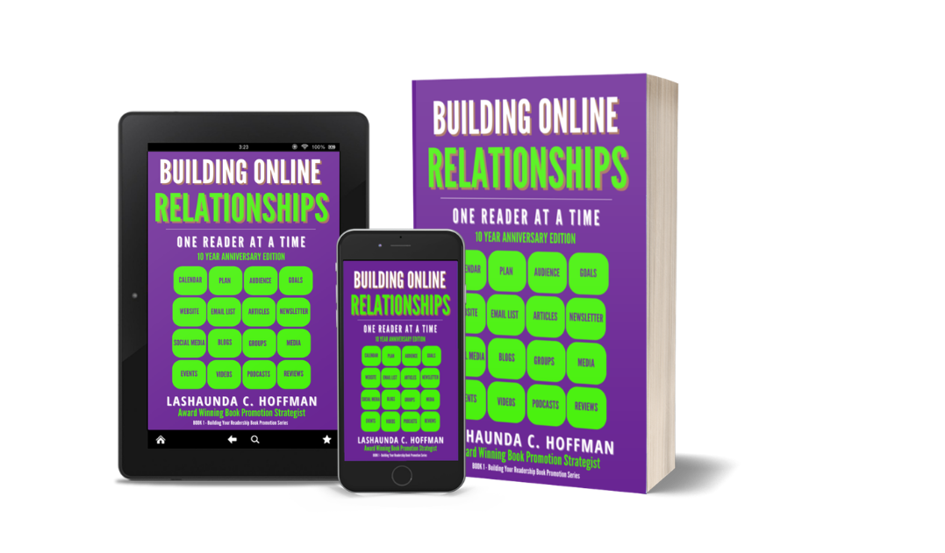
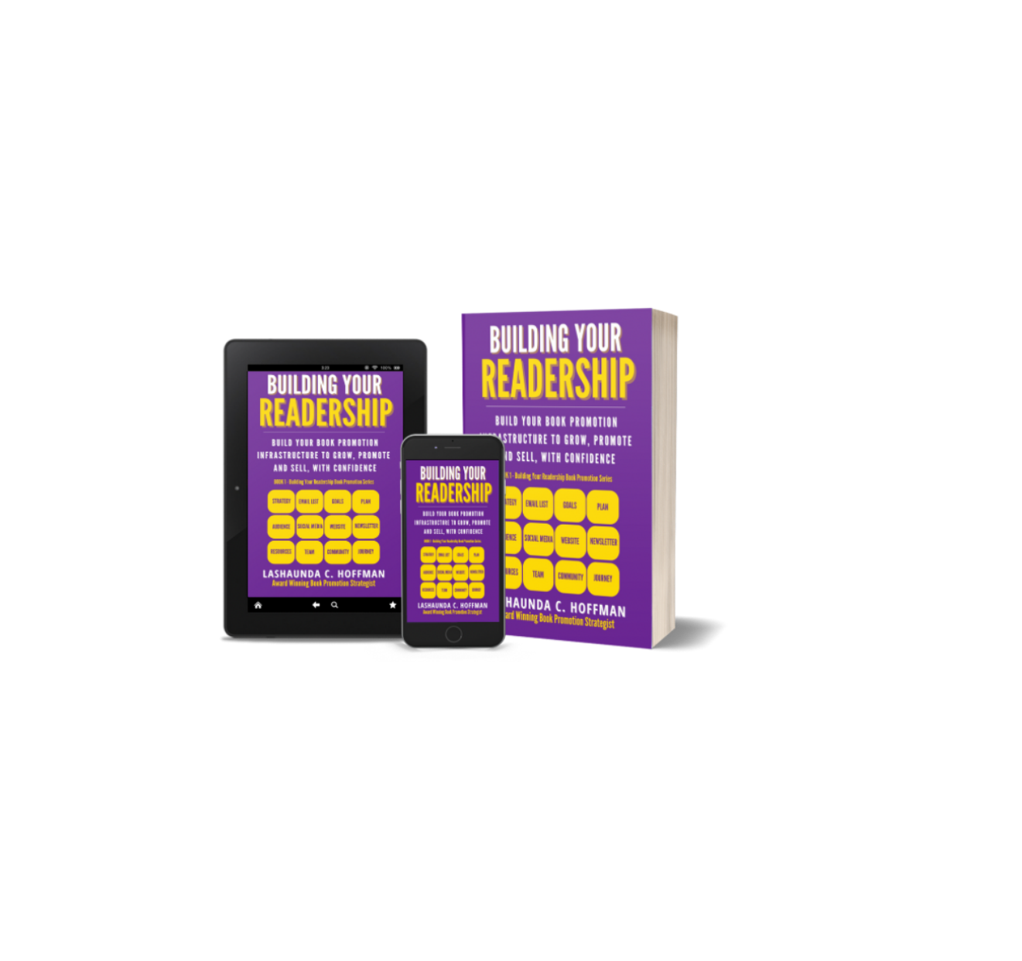
Check Out The Building Your Readership Community
Read The Series
Join Me On Substacks
Building Your Readership Daily for
Weekly Building Your Readership Tips
Work with LaShaunda
https://www.subscribepage.com/virtualtea
http://lashaundahoffman.com
Building Your Readership Series
Creating a 30-Day Promotion Calendar Without Burnout • 21

